Slide 1


Pitching Session
Maestro Symphony
20-22 November, Karlsruhe, Germany
An Eclipse SDV Event

Slide 2

Maestro / Symphony
“Orchestration and automation of fleet management in an highly distributed environment”

Slide 3
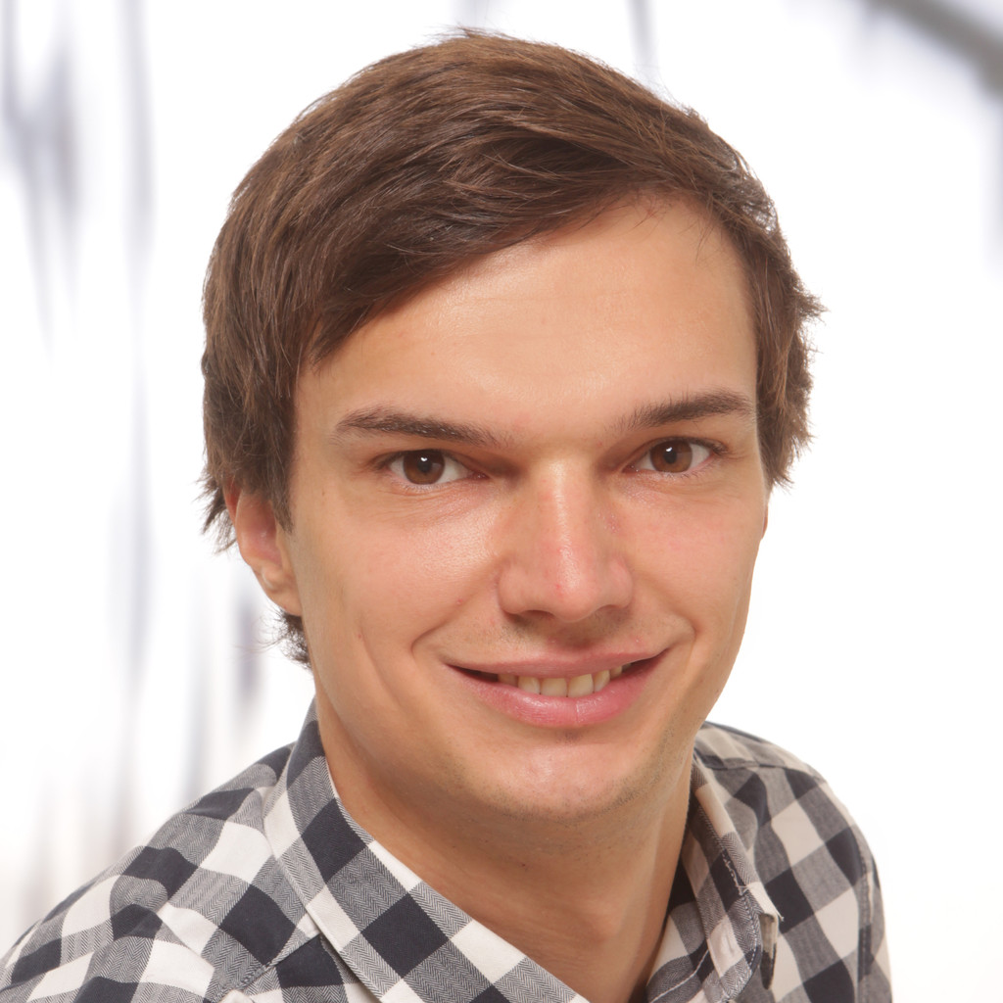
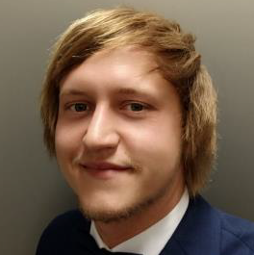
The Team
Markus Kainz
Software Engineer at AVL List GmbH
Markus.kainz@avl.com
Patrick Draxler
Software Engineer at AVL List GmbH
Patrick.draxler@avl.com
Coach: Haishi Bai, Software God

Slide 4
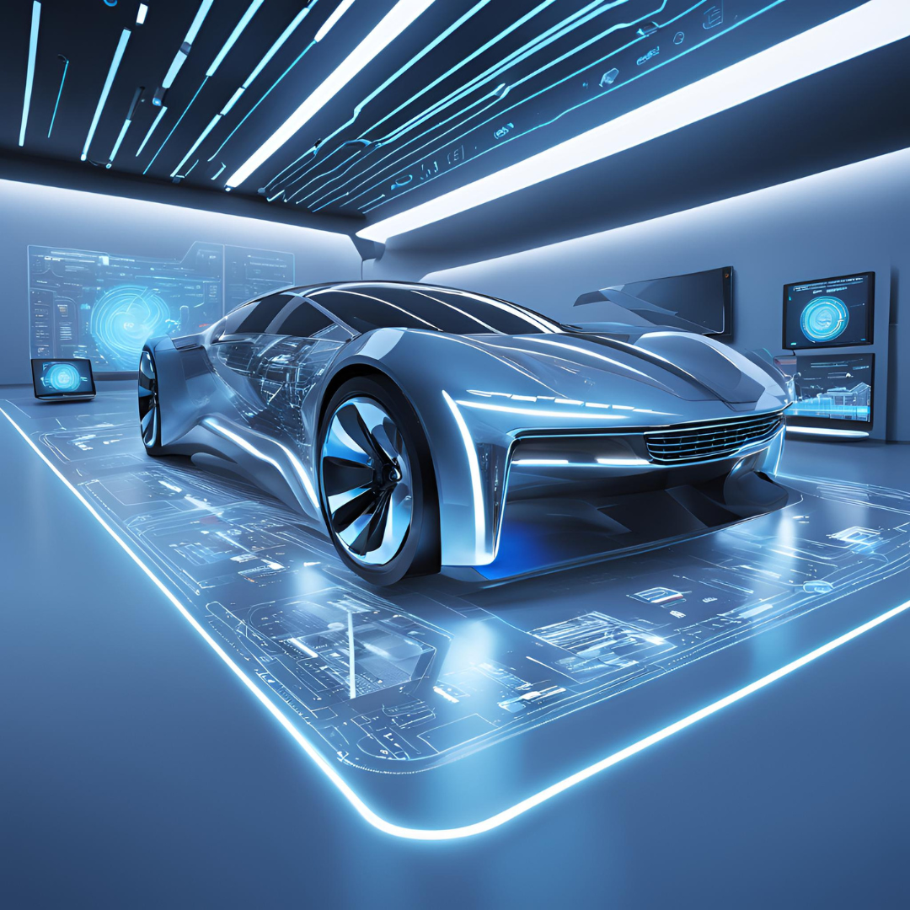
Current Situation
Automotive industry shifting towards SDV
More possibilities e.g. OTA
More data
More complexity
Especially for fleet management

Slide 5
Solution (1/2)
Scalable cloud solution to assist fleet managers in their daily work
Automated data collection and processing
Automatization of repetetive tasks
Reporting and traceability
Using open source tools

Slide 6
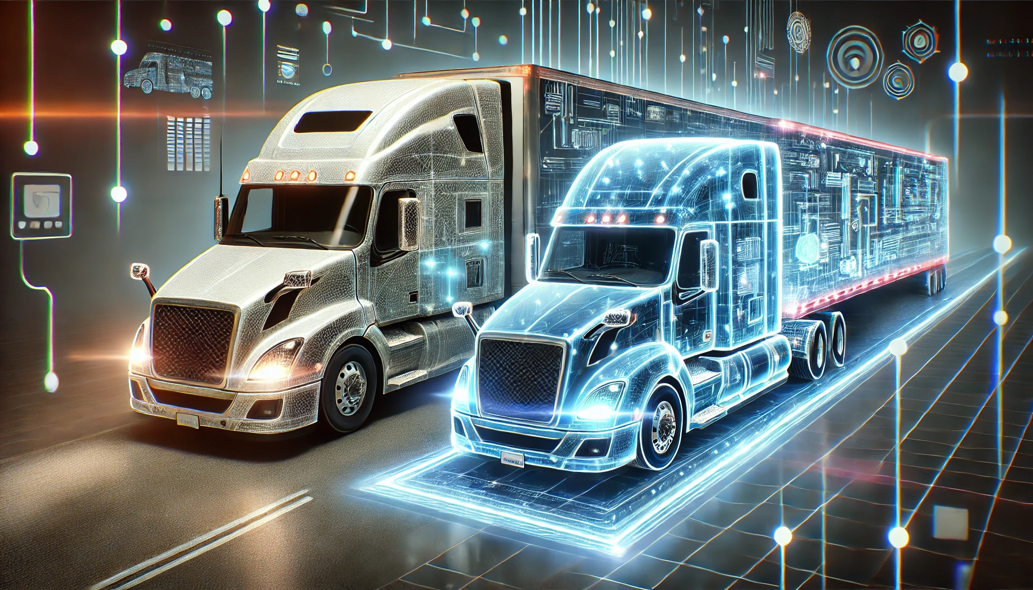
Solution (2/2)
Automated detection of incoming trucks
Creation of digital twins
Read and process vehicle data
Event driven notifications
Trigger events to modify the actual vehicle
Sync with digital twin

Slide 7
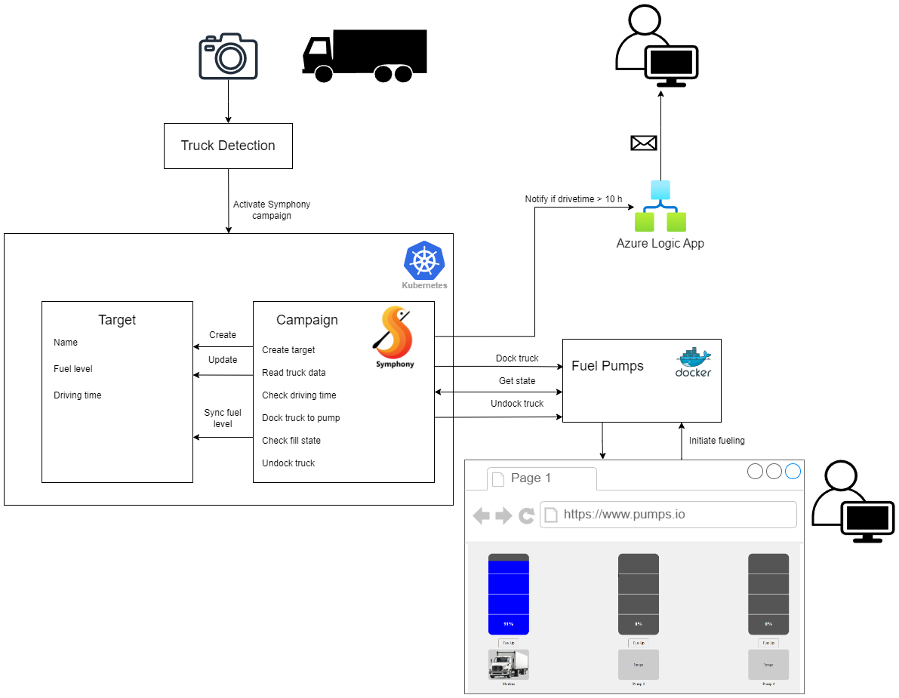
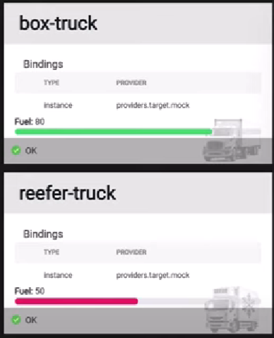
Implementation
Opera Dashboard

Slide 8
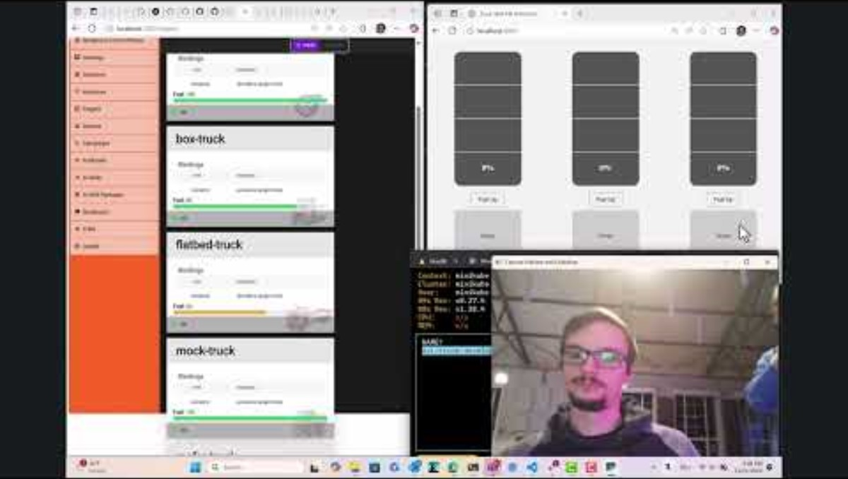
Demo
Notes:
https://www.youtube.com/watch?v=KTsO3etJpBc

Slide 9
Business Model
Subscription Plans
Monthly or
annual SaaS pricing tiers
based on fleet size and features
Usage-Based Pricing
Pay-per-use for additional services (e.g., advanced analytics, AI modules).
Professional Services
Custom integrations
trainings
consulting
Potential Upsell Opportunities
Compliance modules.

Slide 10
Technology Stack
Eclipse Symphony
Docker
Kubernetes
Minikube
K9s
Python FastAPI
Python Yolo Image Recognition
Kubectl
Azure Logic App
HTML5
WSL
Mage
Go
Maestro
…

